Slide 1
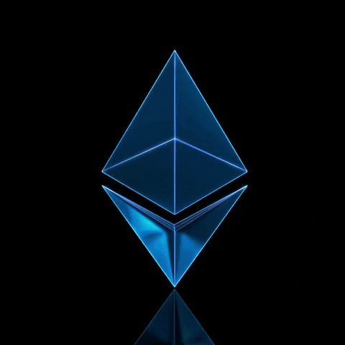
BUET CSE FEST 2023
HACKATHON WEB3
Team GGWP

Slide 2


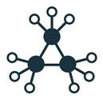

ARTeVERSE
Artwork Supply Chain Website
Supply Chain Streamline Process Of Artworks
Verify artwork’s Authenticity Ownership

Slide 3
Proposed Solution
Creator
Upload artwork and it’s Metadata
Store Artwork Image and Metadata in the IPFS
Upload Corresponding Hash to the Blockchain
Initiate Delivery and show the full delivery process along with updating Delivery Status.
Show Premium artworks in the Art Marketplace for bidding
Get Royalty profit as the original creator.

Slide 4
Proposed Solution
Buyer
Browse, search and filter the artworks
Can Place order to buy preferable artwork with 10% price
Can confirm buying process by paying remaining 90% after delivery
Can place a bid for premium artworks
Can verify the certificate of authenticity

Slide 5
Proposed Solution
Verifier
Verify an artwork
Issue Certificate against the artwork
Make the certificate soul bound NFT

Slide 6







Technologies
Frontend
NFT Contract
Wallet
Design
IDE
Library

Slide 7

Let us now demonstrate the project

Slide 8
Technical Challenges
Issue and Verify certificate
Automated testing and deployment
Royalty Management and Integration
Mint NFT to issue certificate
Implementing Fee Split and premium Auction
Management

Slide 9
Gas fee optimization (unchecked, local storage variable to reduce write operation)
User friendly interface
Automating the deployment and testing process.
Best Practices

Slide 10

jsureka/BUET_HACKATHON_2023 (github.com)
Github link

Slide 11
THANK YOU

